Slide 1
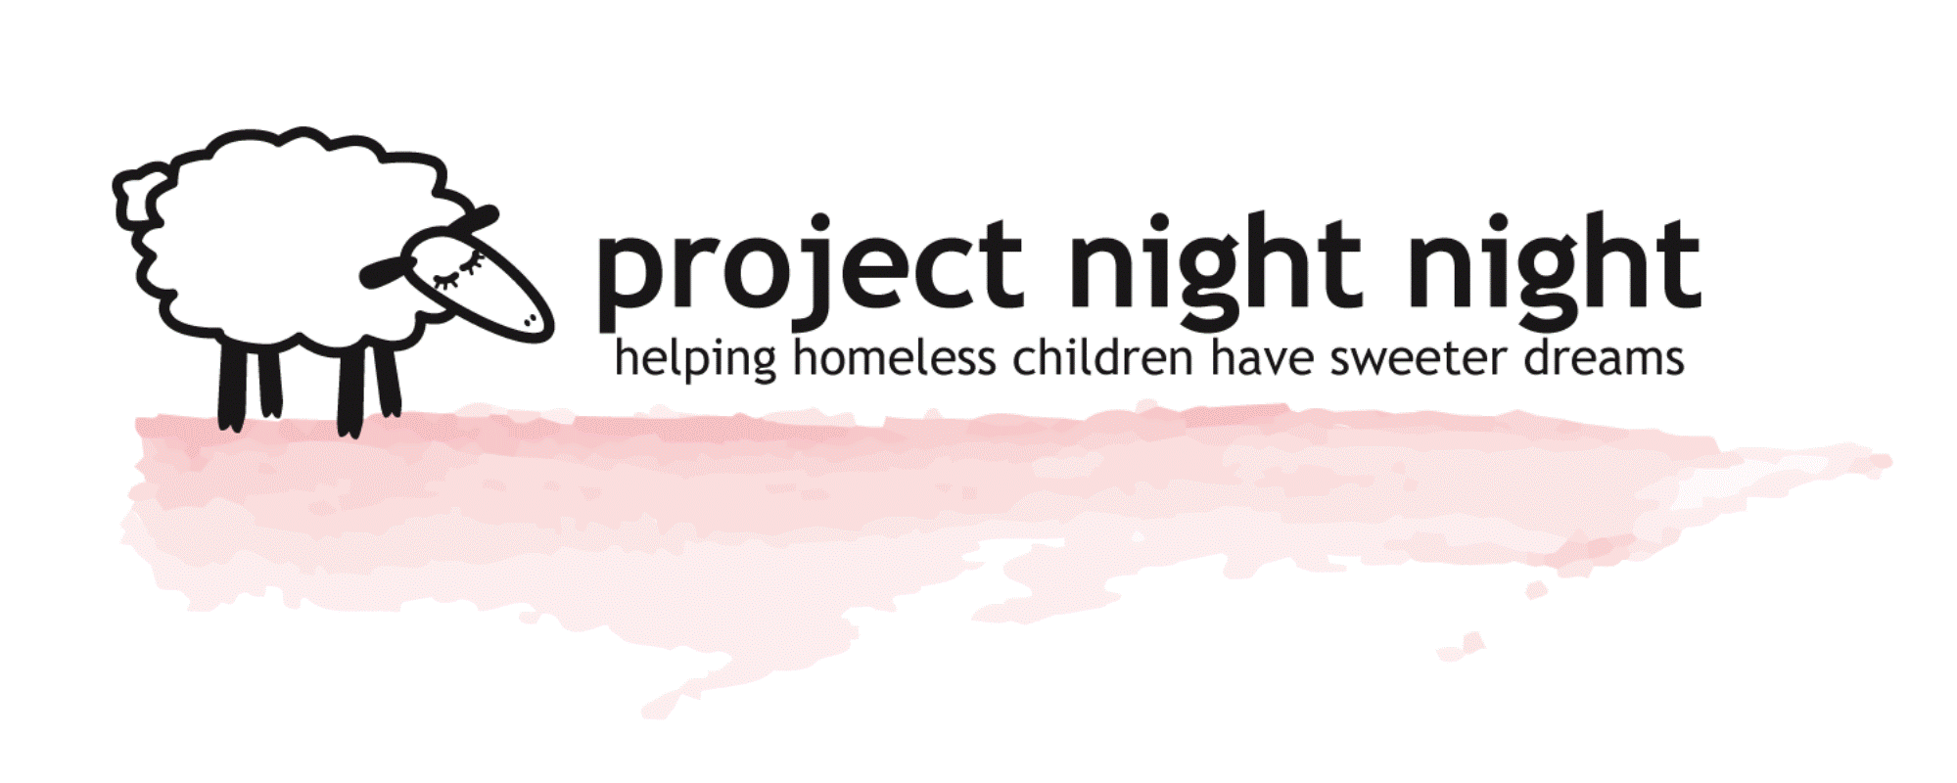
Corporate Community
Services Sponsors
Helping homeless children have sweeter dreams…

Slide 2

About Project Night Night

Slide 3
About Project Night Night
A 503(c)(3) tax-exempt organization

Slide 4
About Project Night Night
Began with a belief that every child deserves a good night’s sleep

Slide 5
About Project Night Night
Began with a belief that every child deserves a good night’s sleep
…and that homeless children are overlooked.

Slide 6
About Project Night Night
Supports the needs of children in homeless shelters throughout the U.S.

Slide 7
About Project Night Night
Supports the needs of children in homeless shelters throughout the U.S.
…by providing objects of reliable comfort to them

Slide 8
About Project Night Night
How we are able to support
Whom we support
Corporate Sponsors
Homeless Children to Age 10
Individual Sponsors
Over 300 Homeless Shelters in U.S.
Cash and In-kind Donations
Domestic Violence Shelters in U.S.
10,000 Volunteers Annually
Together we are tipping the scale!!

Slide 9
About Project Night Night
Promoting Sleep Wellness
  With nighttime basics for homeless children in shelters throughout U.S.
Promoting Emotional Well Being
  Helps relieve child’s emotional anxiety of shelter living
Promoting Cognitive Well Being
  Encourages reading and family bonding

Slide 10
About Project Night Night
We can accomplish great things by giving a “Night Night Package” to every child in need.
Promoting Sleep Wellness
Promoting Emotional Well Being
Promoting Cognitive Well Being

Slide 11
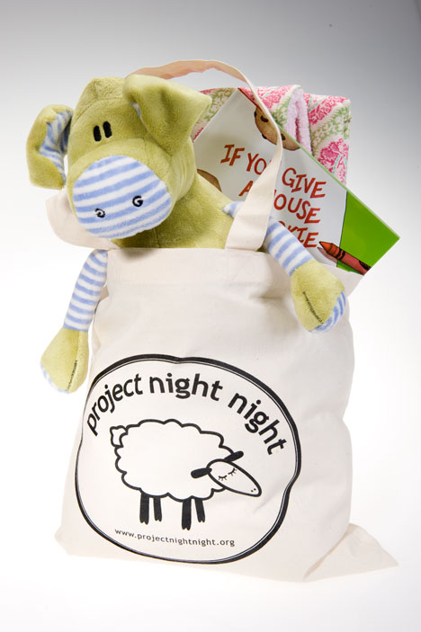
The Night Night Package

Slide 12
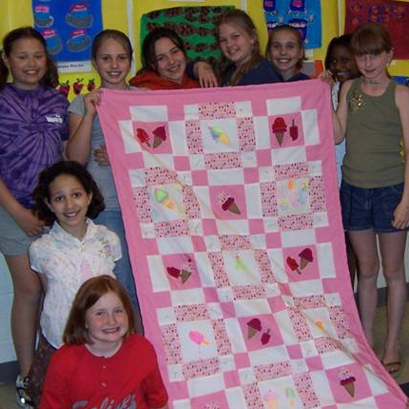
The Night Night Package
The Night Night Package contains:
A high quality blanket to snuggle with – provides security and comfort…

Slide 13
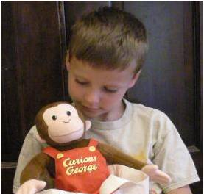
The Night Night Package
The Night Night Package contains:
A stuffed animal that becomes a cherished nighttime friend..

Slide 14

The Night Night Package
The Night Night Package contains:
A book to encourage cognitive skills and family interaction...

Slide 15
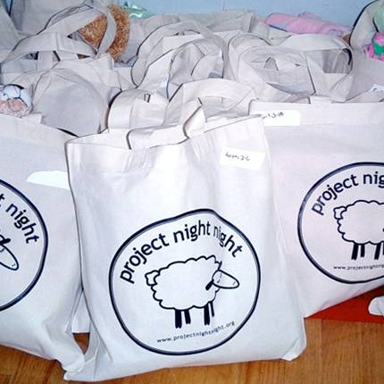
The Night Night Package
The Night Night Package contains:
A well- constructed canvas tote in which to keep belongings.

Slide 16
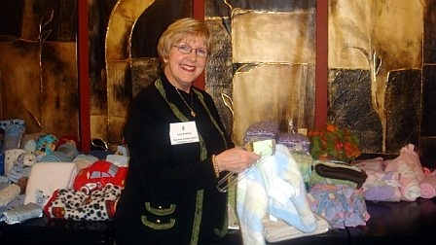
Corporate Sponsors and Volunteers

Slide 17
Corporate Sponsors and Volunteers
Without Corporations and their employees, Project Night Night could not reach as many children across the country who need our support.

Slide 18
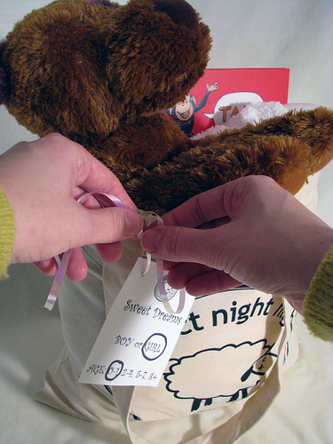
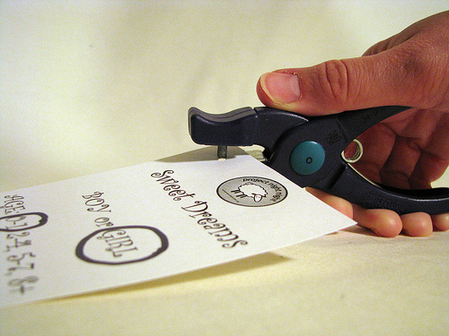
Corporate Sponsors and Volunteers
Volunteers assemble Night Night Packages and apply appropriate tags to the packages that indicate each child’s age and gender at
“The Assembly Event”

Slide 19
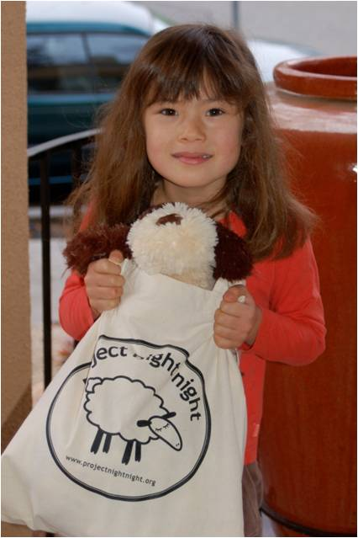
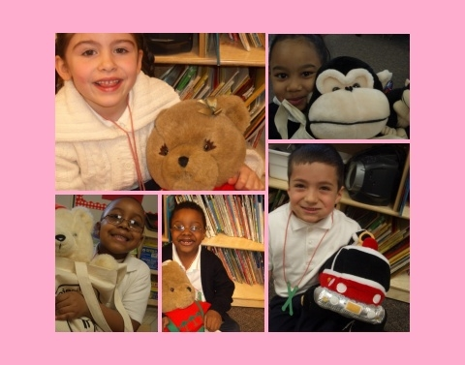
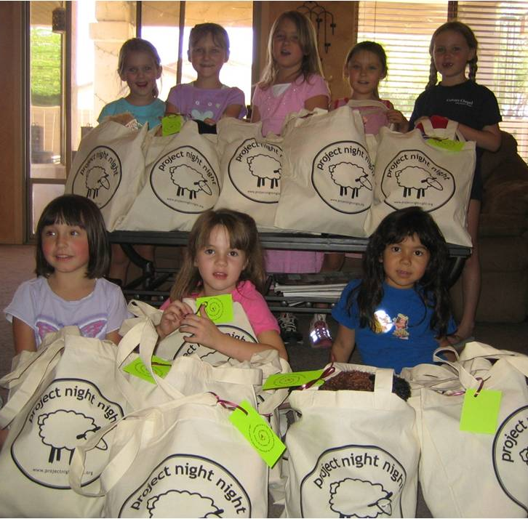
Corporate Sponsors and Volunteers
Volunteers deliver the Night Night Packages.

Slide 20
Project Night Night Accomplishments

Slide 21
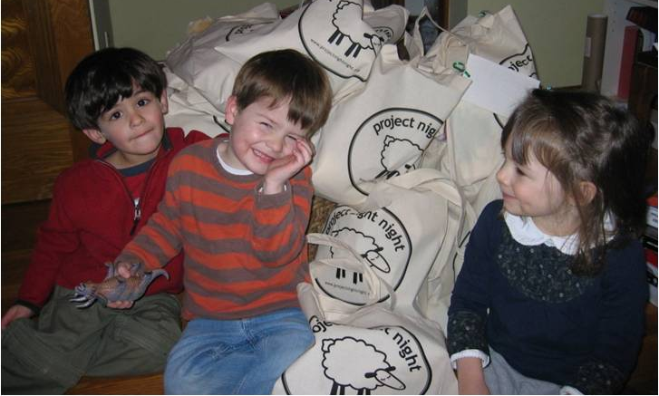

Project Night Night Accomplishments
“Best Children’s Charity””

Slide 22
Project Night Night Accomplishments
Leading provider of nighttime comforts for homeless children in the U.S.

Slide 23
Project Night Night Accomplishments
Donates over 25,000 Night Night Packages per year

Slide 24
Project Night Night Accomplishments
Redistributed over 40,000 books in communities to aid educational needs since 2005

Slide 25
Project Night Night Accomplishments
Environmental repurposing of gently used, “like-new”, books and stuffed animals to over 25,000 children in Night Night packages

Slide 26
Project Night Night Accomplishments
Assists thousands of volunteers connect and impact their communities

Slide 27
Project Night Night Accomplishments
Nationally recognized in magazines : Parents, Glamour, Redbook, Shape, Cookie; and by The Insider TV show.

Slide 28
A note from Kendra Robins, Founder
We are delighted that your organization has come on board to help us provide our Night Night Packages to even more children this year, and pleased that you want to learn more about Project Night Night.

Slide 29
A note from Kendra Robins, Founder
Here are some additional facts that you should know:

Slide 30
A note from Kendra Robins, Founder
Here are some additional facts that you should know:
  In 2007, the homeless families in the US reached nearly 300,000; the highest number since the Great Depression.

Slide 31
A note from Kendra Robins, Founder
Here are some additional facts that you should know:
  The environmental stresses of homelessness also leads to anxiety, depression, poor sleep habits and behavioral issues.

Slide 32
A note from Kendra Robins, Founder
Here are some additional facts that you should know:
  Children who are homeless often have lower academic achievement, exacerbated by frequent moves, lack of privacy and psychological distress, than do children with homes.

Slide 33
A note from Kendra Robins, Founder
Here are some additional facts that you should know:
  Many homeless children report that they had difficulty finding a quiet place to study or do homework while in the shelter.

Slide 34
A note from Kendra Robins, Founder
We want to recognize businesses, like yours, that have displayed a deep sense of commitment to the children of the homeless community through their charitable giving and sponsorship of Project Night Night. Together we are helping homeless children have sweeter dreams!
Thank you!

